Slide 1
Pipeline for Transactional Data Analytics for MNC bank
18-June-2024

Slide 2
Contents
Overview
Flow Diagram
Scripts
1. Data Generator
2. RDBMS Table Creation
3. MySQL to ADLS File Connect
4. Streaming Data Uploader to ADLS Container
5. Config File
6. Medallion Architecture: Catalog Initialization
7. User-Defined Functions
8. Bronze Layer: Data Ingestion Script
9. Silver Layer: Cleaning and Transformation Script
10. Gold Layer: Aggregation and Visualization
Power BI

Slide 3
Overview
Global Bank is undergoing a significant digital transformation to enhance its fraud detection capabilities, improve customer segmentation, and optimize its reporting systems. As part of this initiative, the bank requires a robust data pipeline that can efficiently handle real-time transaction data from multiple sources, including global branches and digital channels.
Key Points :
Architecture: Implementing a Delta Lake architecture that supports multiple data layers (Bronze, Silver, and Gold) for raw, cleansed, and aggregated data.
Fraud Detection: Developing a real-time fraud detection system based on rule-based flagging and transaction pattern analysis.
Customer Segmentation :Creating a system that provides actionable insights through customer segmentation and automated reporting.

Slide 4
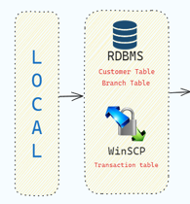
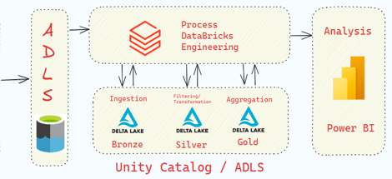

Flow Diagram

Slide 5
Scripts :
1. Data Generator
Description: Script to generate synthetic datasets.
Details:
Generates datasets for 1000 distinct customers.
Generates datasets for 15 branches.
Generates datasets for 50000 transactions
2. RDBMS Table Creation
Description: Create raw tables in MySQL Workbench.
Details:
Define table schemas for customer, branch, and transaction data.
Create tables and insert initial data

Slide 6
3. MySQL to ADLS File Connect
Description: Script to upload tables from MySQL to Azure Data Lake Storage (ADLS) files.
Details:
Connect to MySQL database and read data from tables.
Convert data to a csv format.
Upload data files to ADLS.
4. Streaming Data Uploader to ADLS Container
Description: Script to simulate streaming data.
Details:
Generate transactional data files with 50 records each.
Upload a new file every 30 seconds to an ADLS container.

Slide 7
5. Config File :
Description:
Facilitates easy management of paths and parameters.
Centralizes configuration for easier updates and maintenance.
Helps in creation of dynamic scripts.
Details:
Contains Schema for ingestion
Contains connection details
6. Medallion Architecture: Catalog Initialization
Description: Set up a catalog and schemas following the Medallion Architecture.
Details:
Create a catalog named bank_service.
Define three schemas: Bronze, Silver, and Gold.
Create tables in each schema to organize data processing stages.

Slide 8
7. User-Defined Functions
Description: Custom functions for data processing.
Details:
Analyze Dataframe: Analyze dataframe and give basic information about data like rows, columns, null count, duplicates, etc.
Typecast Column: Ensure correct data types for columns.
Handling Null Values Drop: Remove rows with null values.
Strip Empty Space: Remove leading and trailing spaces.
Remove Special Characters: Clean data by removing unwanted characters.
Handling Duplicates: Remove duplicate records.
Change Case: Standardize text data to a consistent case.

Slide 9
8. Bronze Layer: Data Ingestion Script
Description: Script to ingest raw data into the Bronze layer.
Details:
Load data from ADLS into a DataFrame in Databricks.
Store ingested data into Bronze tables.
Static Data:
Customer table.
Branch table.
Streaming Data:
Transaction table (using Databricks Autoloader for streaming ingestion).

Slide 10
9. Silver Layer: Cleaning and Transformation Script
Description: Script to clean and transform data in the Silver layer.
Details:
Typecast Column: Ensure all columns have the correct data type.
Handling Null Values Drop: Drop rows with null values to ensure data integrity.
Strip Empty Space: Remove any leading and trailing whitespace from text fields.
Remove Special Characters: Eliminate any special characters that may cause issues.
Handling Duplicates: Identify and remove duplicate records.
Change Case: Convert text data to a consistent case (eg., all uppercase or all lowercase).
10. Gold Layer: Aggregation and Visualization
Description: Aggregation for Visualization.
Details:
Creation of Segment Table aggregation
Creation of Fraud Table aggregation

Slide 11

Power BI
Connected Gold layer data tables to the PowerBI using Azure Databricks connector in PowerBI

Slide 12
Thank You.

